Slide 1
Previously…
Ecological Organization
Biosphere (containing everything)
Biome
Ecosystem
Community
Population
Organism – the individuals

Slide 2
Switching Gears
We’ve looked at how things interact and talked about how those interactions affect the various levels of ecological organization.
For the next unit, we’ll be looking at how organisms are related. Specifically, we’ll be looking at how organisms are classified based on ancestry.

Slide 3
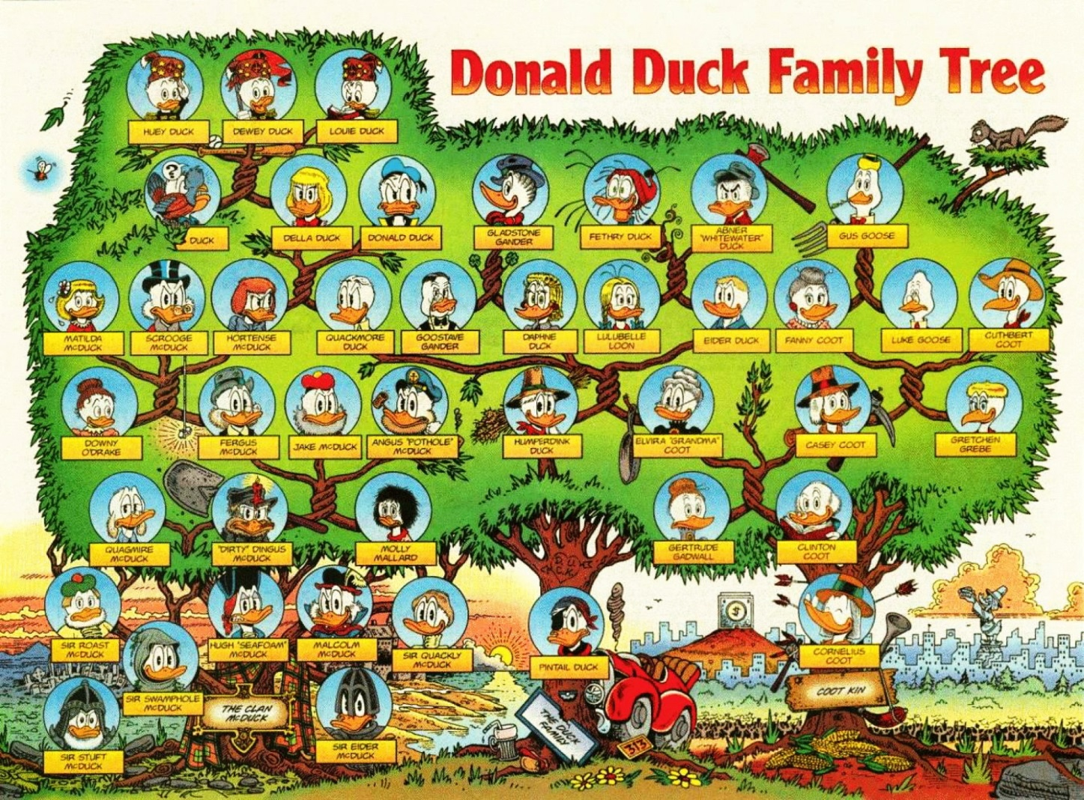
Family Tree Example

Slide 4
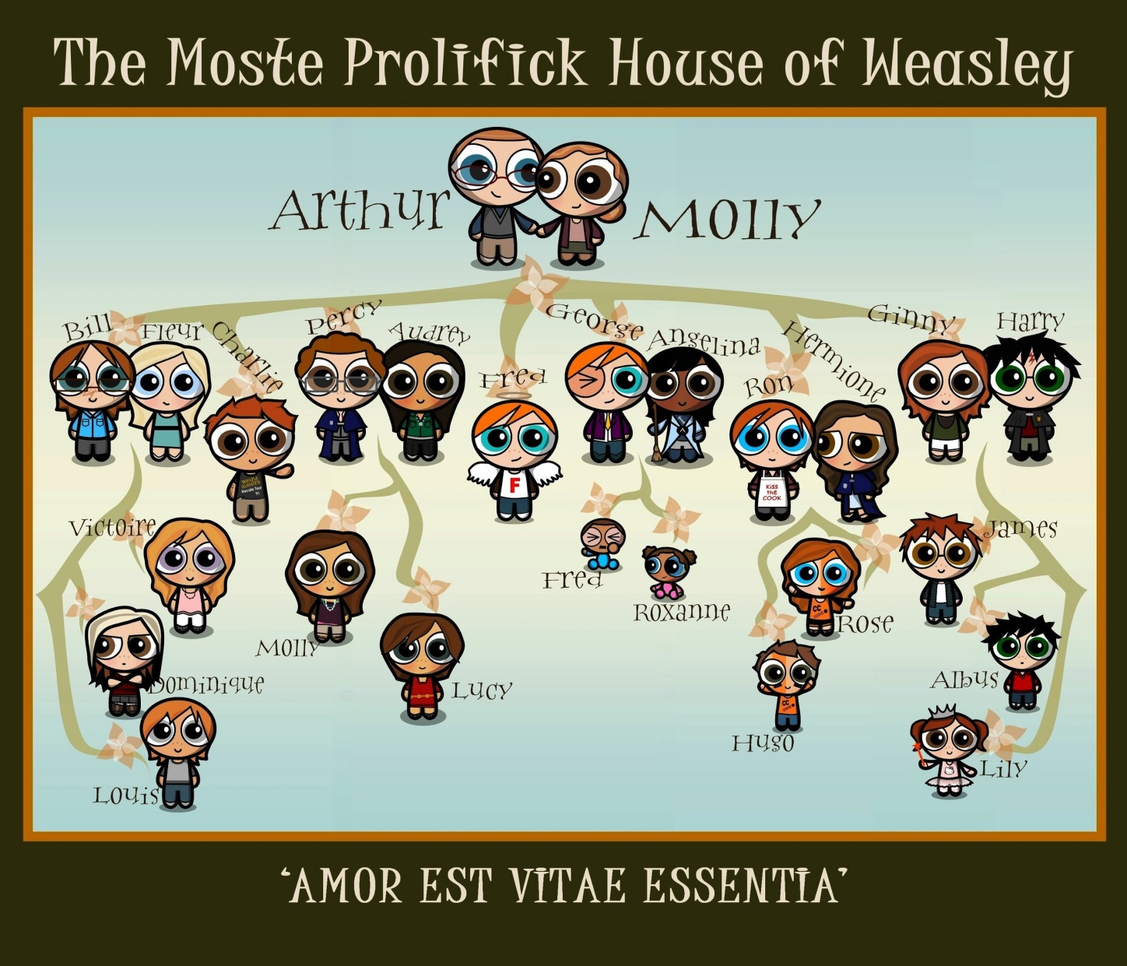
Family Tree Example

Slide 5
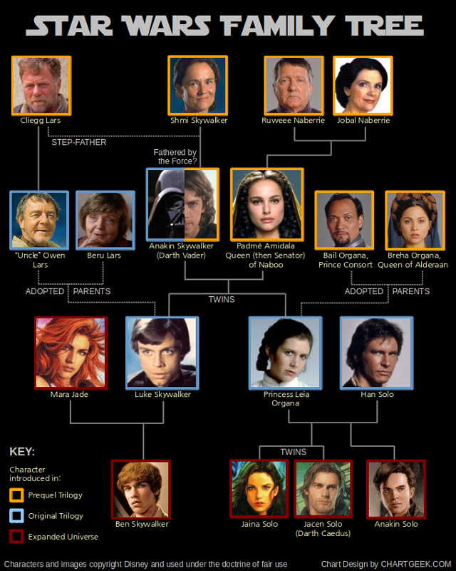
Family Tree Example

Slide 6
Ancestry
Eventually, we will look at ancestry from a genetic standpoint, as with a family tree.
For now, ancestry refers to a common ancestor, which is an the most primitive version of all related organisms.

Slide 7
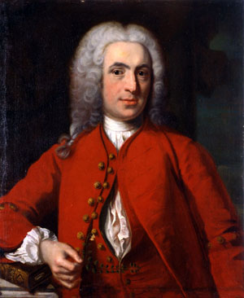
Carl Linnaeus (1707-1778)
Swedish botanist, zoologist, and professor.
Changed his name to Carolus because
  He was obsessed with Latin
  He was obsessed with classifying things.
His obsessions led to the standard classification system we use today.

Slide 8
Some Vocabulary
Taxonomy: the science of naming and classifying organisms.
  Typically uses physical or structural traits
  Creates a hierarchy of organisms
A group within the system is called a taxon. We will often refer to different taxa as we talk about groups.
Species will refer to a group of organisms that can breed and reproduce, and whose offspring are viable and also able to reproduce.

Slide 9
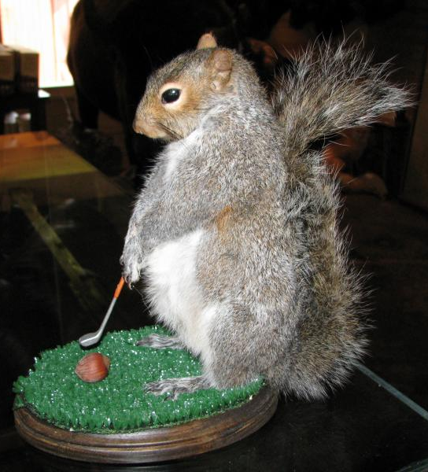
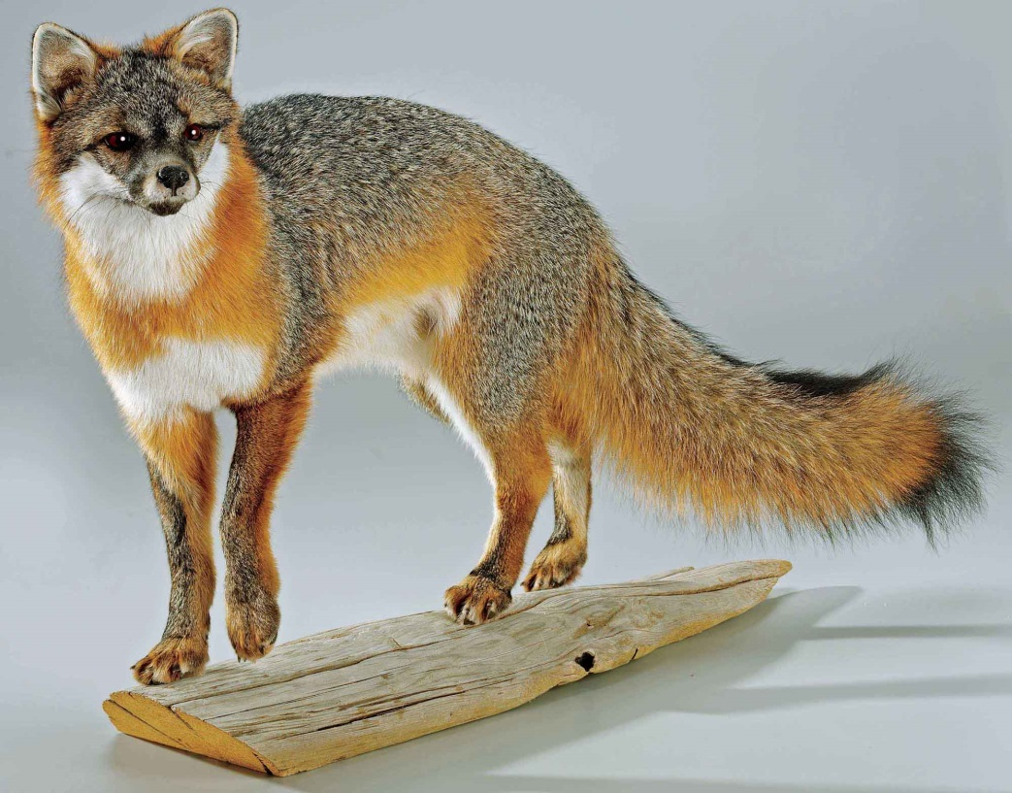
Taxidermy

Slide 10
Linnaeus’ System
Focuses on binomial nomenclature, which Linnaeus developed using…
  LATIN!
All individuals belong to a genus and a species.
  Genus names are always italicized when typed or underlined when written. They are also always capitalized.
  Species names are always italicized when typed or underlined when written. These are always lower case.
  The species name is the specific descriptor that sets individuals apart, such as a trait, a native habitat, or the name of the person who discovered it.

Slide 11
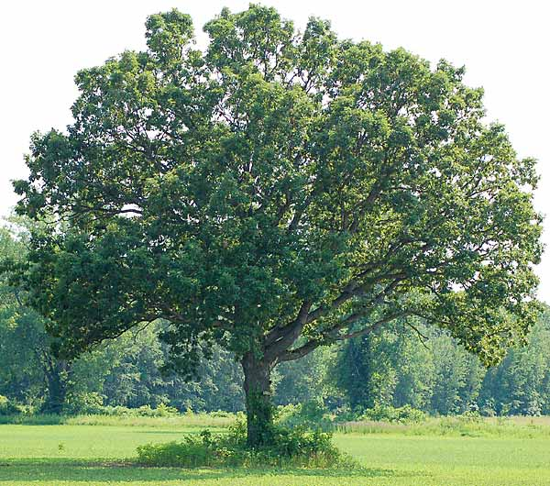
White Oak Tree
Quercus alba

Slide 12
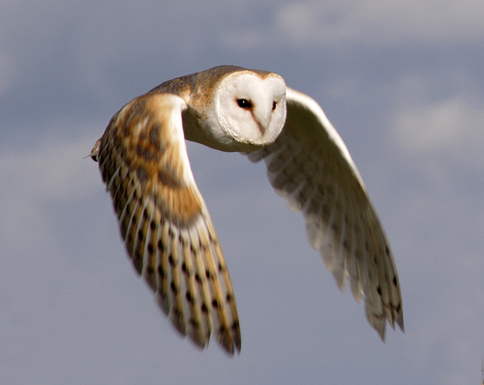
Barn Owl
Tyto alba

Slide 13
Why binomial nomenclature?
The same species could have many common names, either within regions of a country or across the globe.
Specific names and descriptors allow global communication without confusion.
Some genera (plural form of genus) may contain hundreds of species.

Slide 14
Linnaeus’ System
Kingdom (least specific)
Phylum
Class
Order
Family
Genus
Species (most specific)

Slide 15
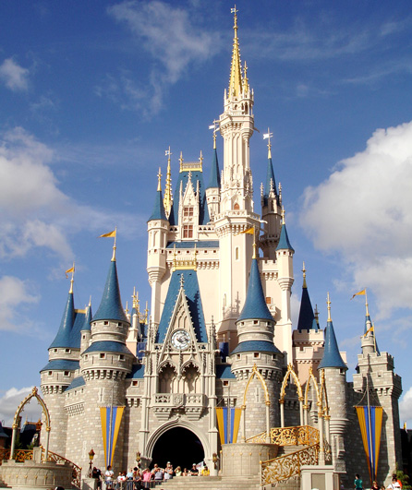
Kingdom

Slide 16
Defining Linnaean Taxonomy
Kingdom: most broad grouping of organisms (kinda)
  Six kingdoms – Animalia, Plantae, Fungi, Protista, Archaea, Bacteria
Phylum: taxa that sort kingdoms into the most basic characteristics.
  There are 35 phyla within kingdom Animalia
Class: more specific traits (111 classes within Animalia)
Order: more specific, often using similar suffixes for closely related orders within a class.
  Example: primates

Slide 17
Defining Linnaean Taxonomy
Family: becoming very specific, only having a few organisms within. Family members often share many traits and can be confused with each other.
  Example: cebidae
Genus: very closely related organisms that share most traits and very often share a common ancestor. Members within a genus often fill the same niche.
  Example: Cebus
Species: the most specific taxa. A species will have one or more defining traits that no other members of the genus have.
  Example: capucinus

Slide 18
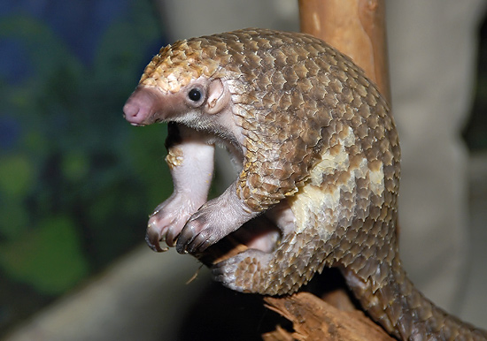
Pangolin

Slide 19
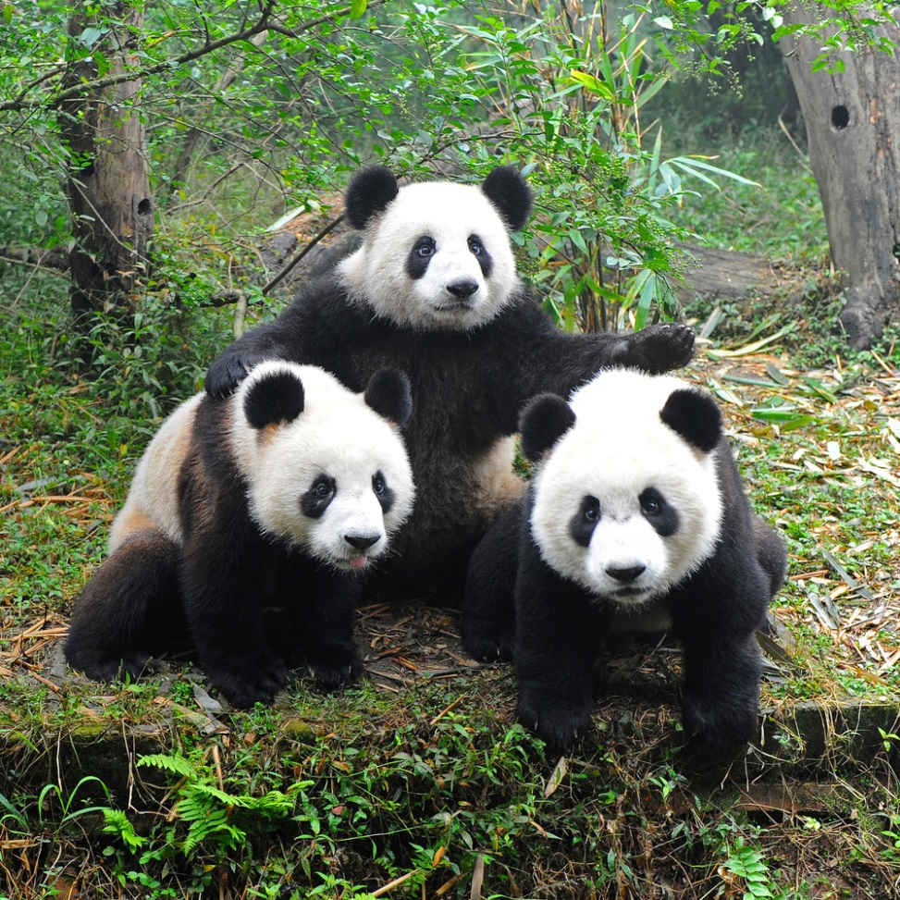
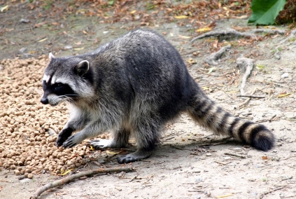
Giant Panda
Raccoon

Slide 20
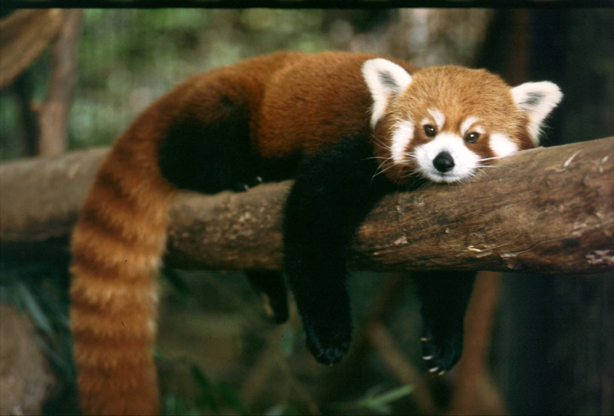
Red Panda

Slide 21
Limitations
Linnaean taxonomy focuses specifically on physical traits and similarities.
In the Linnaean system, completely unrelated species may develop similar traits and therefore be classified together.
Modern technology allows us to look at the genetic information and therefore truly look at a species’ common ancestor.

Slide 22
Cladistics

Slide 23
More on Classification
We classify organisms based on common ancestry.
Any group of organisms with a shared evolutionary history is called a phylogeny.

Slide 24
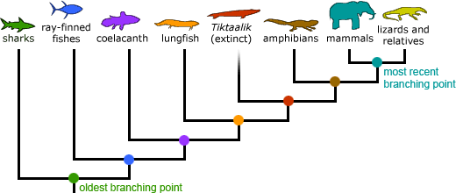
Phylogenies
Phylogenies are often shown as branching tree diagrams, kind of like a family tree.
Each branch shows a relation.

Slide 25
More Specific
Growing more specific than Linnaean Taxonomy:
  Remember: Linnaeus focused purely on physical or structural traits
  Organisms were related simply by looking alike.

Slide 26
Morphology
Linnaean Taxonomy relied 100% on morphology, the structural relationships between organisms.
Modern taxonomy combines morphology with genetics.
  Remember the pangolin?
  It has avian morphology,
  even though it’s a mammal…
  and it’s still cute!

Slide 27
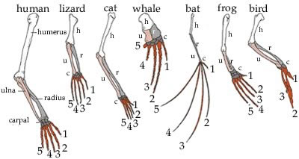

Slide 28
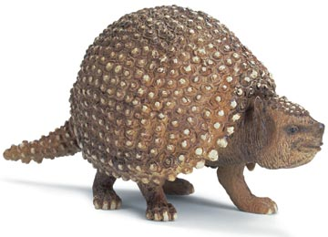
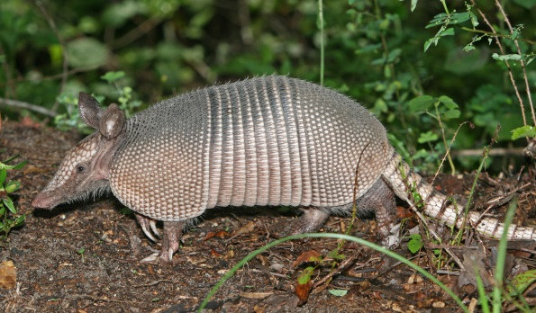
Cladistics
Cladistics is classification based on common ancestry.
  This combines Linnaean Taxonomy (morphology) with evolutionary theory.
Goal: Sort species into branches (IN ORDER) based upon common ancestry.
  Example: Glyptodon Armadillo

Slide 29
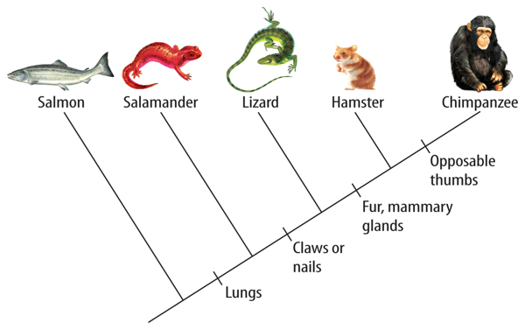
Cladograms
Diagrams of the evolutionary tree showing the relationship between organisms based on common ancestors.
Root: clade, a group of species sharing a common ancestor; from the Greek meaning “branch”

Slide 30
Evolution
Cladograms show evolution more clearly than Linnaean Taxonomy.
Over the course of time, certain traits have emerged or changed.
Some groups may share one trait but no other traits.
As traits evolve, we call them derived characters, or states of appearance.

Slide 31
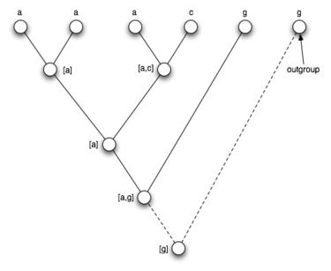
Relations
Groups that are more closely related will share many derived characters.
Any group that shares no derived characters is called an outgroup.

Slide 32
Reading a Cladogram
Derived Characters – on the main branch, beginning at the bottom left and moving toward the top right.
Nodes – each spot where a branch splits away, where the first node (bottom left) represents the common ancestor.
Clades – groups sharing a common ancestor.

Slide 33
More Advanced Reading
Monophyletic – share common ancestry completely.
Paraphyletic – share common ancestry, but clade does not include all derived characters.
Apomorphic – advanced derived characters, or more evolved traits.
Plesiomorphic – primitive derived characters, or less evolved traits.

Slide 34
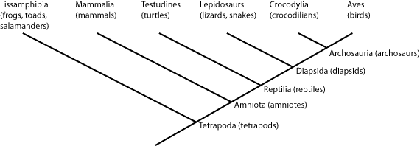
Example Clade

Slide 35
The Big Picture
Linnaean Taxonomy focuses on morphology.
Cladistics merges morphology and evolution.
We get the whole picture by looking at molecular evidence along with morphology and cladistics.

Slide 36
Molecular Evidence
DNA Sequences
Protein Synthesis
  Use of this evidence helps scientists to rearrange taxa and clades to more accurately show evolution and relationships.
  Molecular evidence also helps measure evolutionary time.

Slide 37
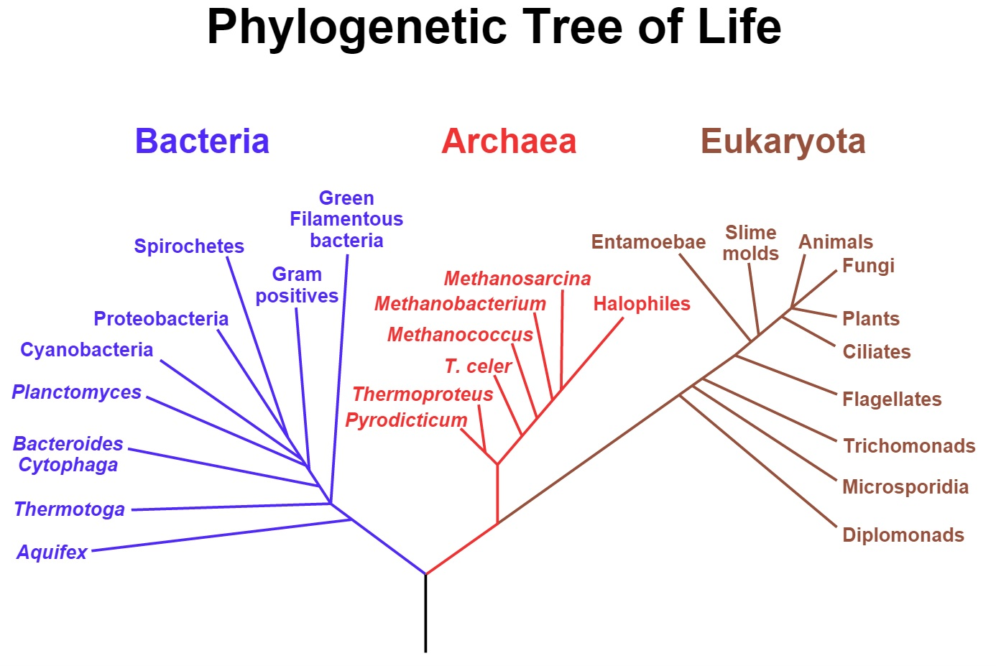

Slide 38
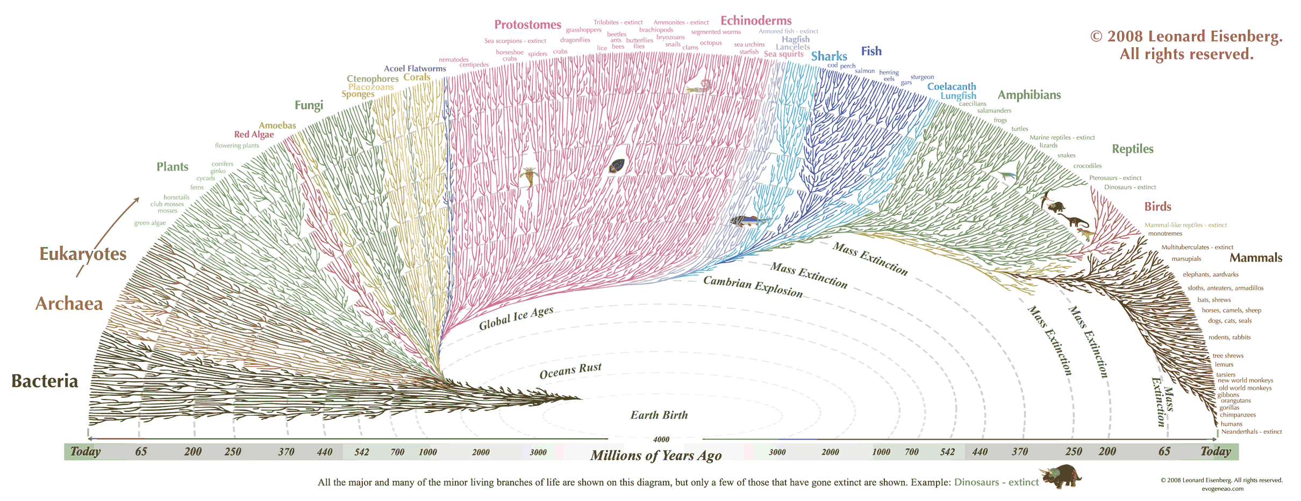

Slide 39
http://www.oceanographerschoice.com/log/wp-content/Evo_large.gif

