Slide 1
Biomes Review

Slide 2
Types of Biomes
Tropical Rainforest
Grassland (Tropical and Temperate)
Desert
Temperate Forest (Deciduous and Rain)
Taiga
Tundra

Slide 3
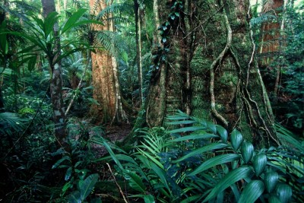
Tropical Rainforest
Characteristics:
  Heavy Rainfall
  Constant warmth
Climate Flora
  Many species of
  broad-leaved plants
Climate Fauna:
  Snake
  Monkey
  Leopard

Slide 4
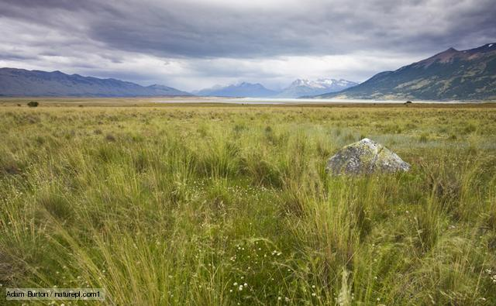
Grassland
Characteristics:
  Considerable variability
  in rainfall and temperature
  Strong, prevailing winds
Climate Flora
  Grasses
Climate Fauna:
  Pronghorn antelope
  Prairie dog
  Bison

Slide 5
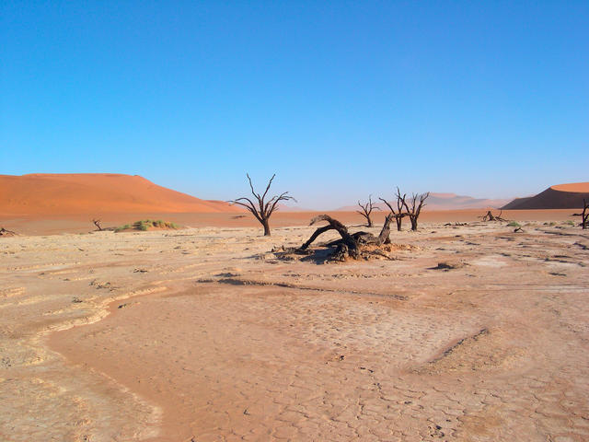
Desert
Characteristics:
  Sparse rainfall
  Extreme daily temperature
  fluctuations
Climate Flora
  Drought-resistant shrubs
  Succulent plants
Climate Fauna:
  Kangaroo rat
  Lizard

Slide 6
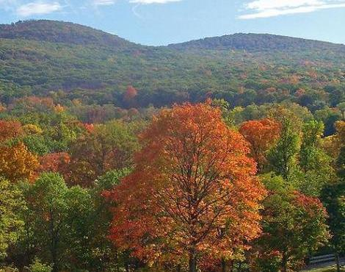
Temperate Forest
Characteristics:
  Moderate precipitation
  Cold winters
  Warm summers
Climate Flora
  Trees that shed leaves
  (deciduous)
Climate Fauna:
  Grey Squirrel
  Fox
  Deer

Slide 7
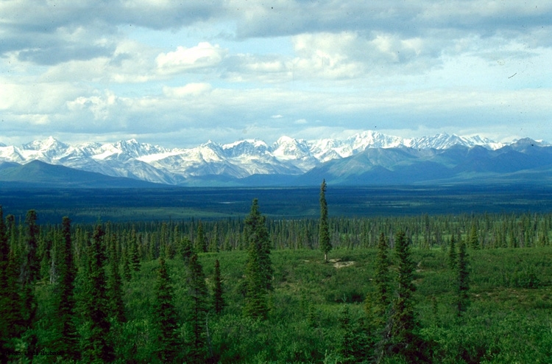
Taiga
Characteristics:
  Long, severe winters
  Summers with thawing subsoil
Climate Flora
  Conifers
Climate Fauna:
  Moose
  Black Bear

Slide 8
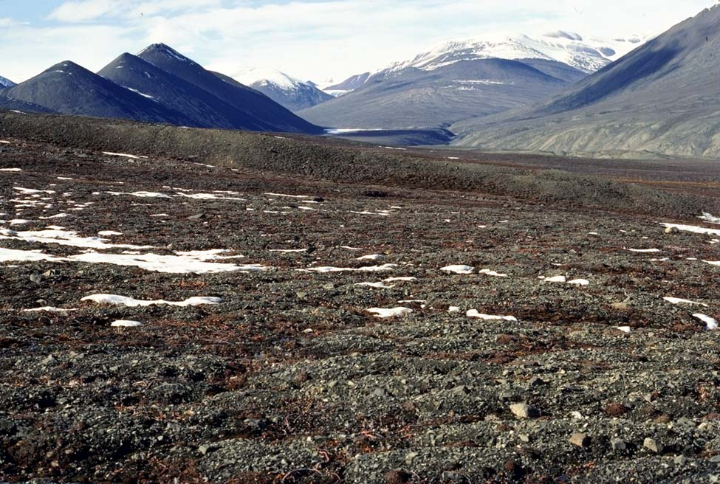
Tundra
Characteristics:
  Permanently frozen subsoil
Climate Flora
  Lichens
  Mosses
  Grasses
Climate Fauna:
  Caribou
  Snowy owl

Slide 9
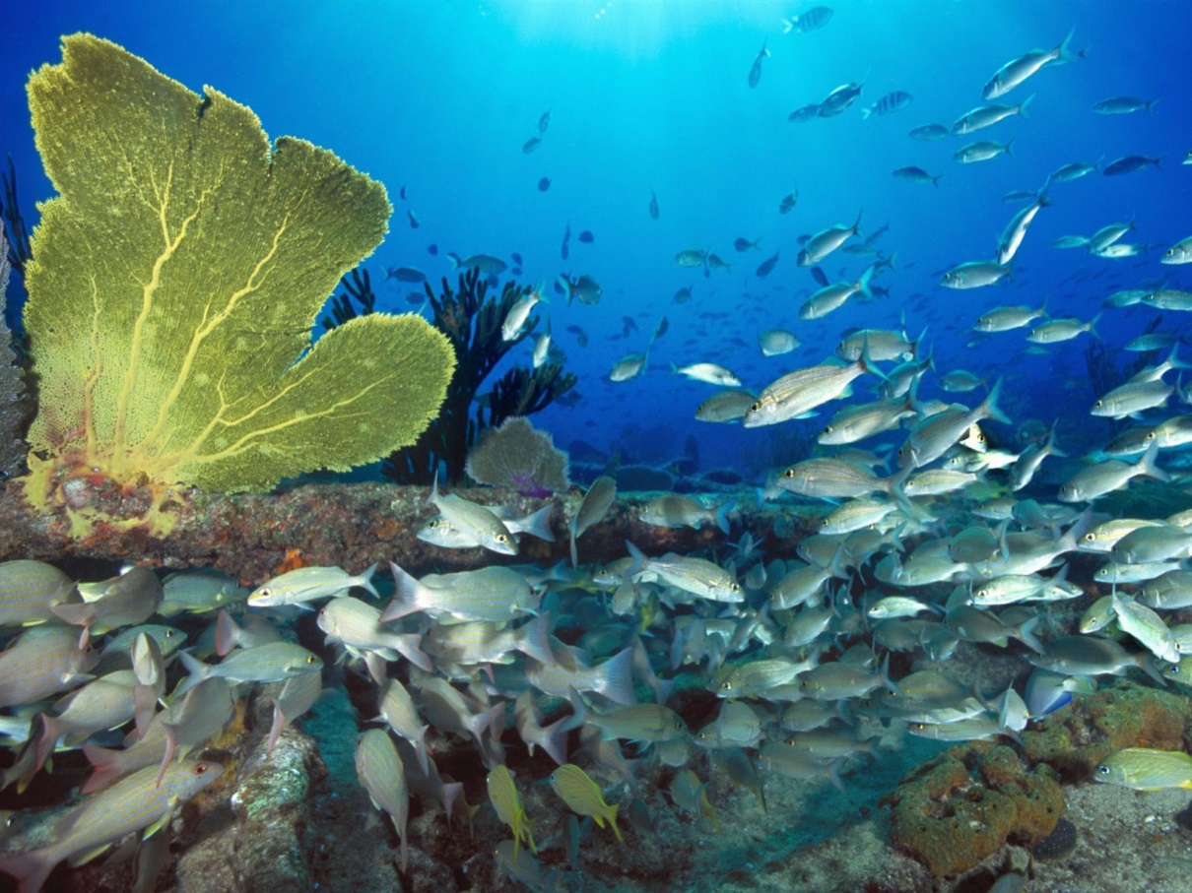
Minor and Non-Biomes
Minor Biomes
  Chaparral
  Marine
Non-Biomes
  Mountains
  Polar Ice Caps

