Slide 1
Group and Individual Interactions

Slide 2
Organism Interactions with Environment
Habitat: All of the biotic and abiotic factors in the area where an organism lives.
Ecological Niche: All the physical, chemical, and biological factors a species needs in order to survive , stay healthy, and reproduce.
Think of the habitat as where an organism lives and the niche as how the organism lives and interacts within the environment.

Slide 3
Niches
Food: The type of food a species eats, how it competes for the food, and where the species fits in the food web
Abiotic Factors: Temperature, rainfall, and other conditions that a species can tolerate from its environment.
Behavior: The time of day a species is active as well as where and when reproduction occurs.
These three factors determine how a species interacts with its environment and what niche the species fits into.

Slide 4

Competition
Two species will sometimes use the same resources in the exact same way. In other words, they both occupy the same niche.
Competitive Exclusion: Occurs when two species compete for the same resource and one species is better adapted than the other.

Slide 5
Outcomes of Competitive Exclusion
Extinction: D-E-D. Species dies out completely. May not be global extinction, but possible.
Happier Outcomes:
Niche Partitioning: Natural divisions occur between species based on competitive advantages.
    Example: One type of squirrel may be lighter and can eat nuts from the tops of trees while another type of squirrel has to eat nuts from lower branches or the ground.
Evolutionary Response: Divergent evolution in order to occupy different niches.
    Example: One type of squirrel develops larger teeth to allow it to crack large nuts while the other type maintains smaller teeth for smaller nuts and seeds.

Slide 6
What if…
Two organisms occupy the exact same niche. However, these two organisms live in entirely different habitats. What do we call these organisms?

Slide 7
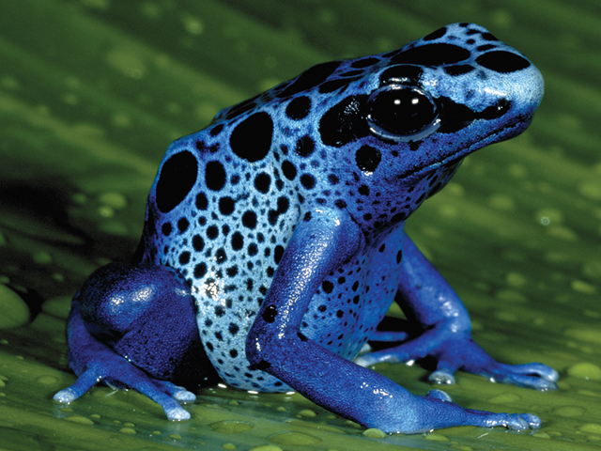
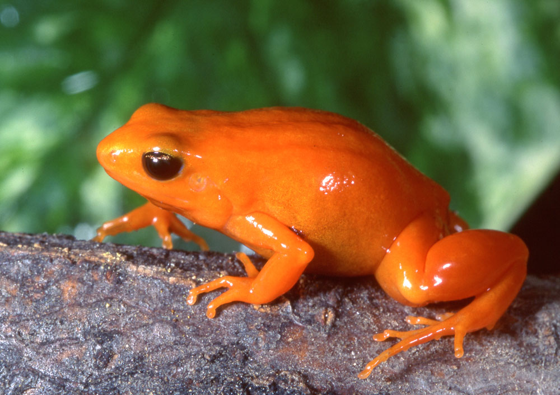
Ecological Equivalents
Poison Dart frog
Mantella Frog

Slide 8
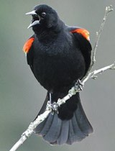
More on Competition…
Competition will always occur when two organisms fight over the same limited resources.
Two different types:
  Interspecific: Two different species are competing for a limited resource such as plants competing for space in a garden.
  Intraspecific: Individuals of the same species struggle against one another for resources such as birds during breeding season defending their nests.
Red-winged Blackbird

Slide 9

Relationships
Most animals are consumers. They feed on other consumers or on producers.
The consumers are part of a common interspecific relationship.
Predator-Prey: Species that are well-adapted to hunting, killing, and consuming other organisms are predators. Species that get hunted and consumed are prey.
Predation: The process in which one organism captures and feeds upon another organism.
Herbivores are predators because they prey on bushes and grass.

Slide 10
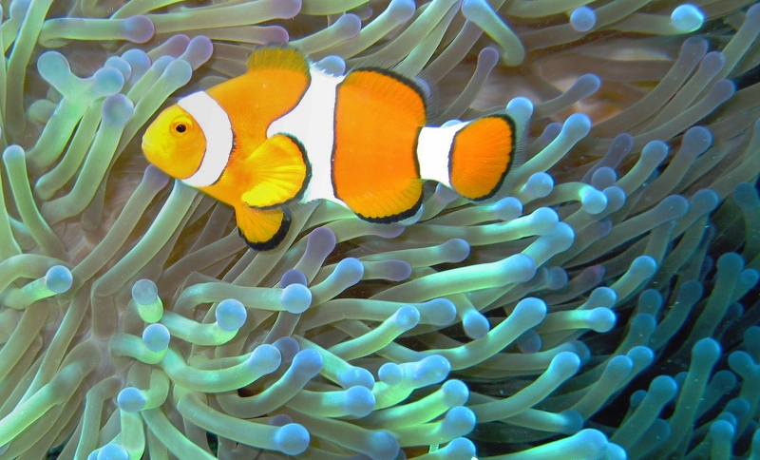
Closer Relationships
Certain organisms develop relationships when they live in direct contact with one another.

Slide 11
Closer Relationships Continued
Symbiosis: Occurs between two or more organisms of different species living in direct contact with one another.
Three types of symbiotic relationships:
  Mutualism: Both organisms benefit from the relationship. An example would be the pollination of various flowers by bees.
  Commensalism: One organism gains a benefit and the other organism neither benefits, nor is harmed. For example: Microscopic mites that live on the ends of hair follicles feed on dead skin cells and secretions from your skin.
  Parasitism: One organism benefits at the expense of the other. Unlike predators, parasites often attempt NOT to kill the host.

Slide 12
Survival Strategies
Recall the survivorship curves we created. Survivorship curves can often give us an indication of behaviors of a species as well as the health of the species.
Type I: Low infant mortality rate and long life span. This type often indicates close parental or group care for infants and offspring.
Type II: Equal chances of living or dying throughout life span. Some group activity in the form of working together but chances of living and dying are mostly from disease or predation.
Type III: High birth and infant mortality rates. Young organisms often suffer from predation. Group must produce thousands of offspring in order to counteract the effects of predation.

Slide 13
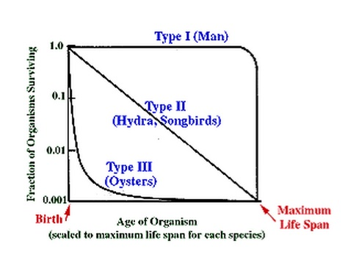
Survival Strategies

Slide 14
Other Group Behaviors
Population Density: The number of individuals in a given space. Population density often determines other behaviors within a group of organisms.
Dispersion: How individuals are arranged within an area.
  Clumped: Groups of organisms remain close together to help facilitate mating, access to food, and also to help avoid predation.
  Uniform: Group remains together but spreads out evenly to best utilize resources available in the area.
  Random: No group structure exists. Instead, individuals are spread randomly and must care for themselves. Often occurs in organisms with few competitors or predators.

Slide 15
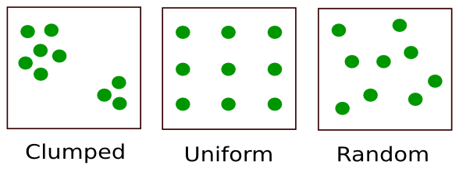
Dispersion Patterns

Slide 16
Changing Populations
Four factors:
Immigration: Individuals enter a population or unoccupied habitat from another population.
Birth: New individuals are born into a population.
Emigration: Individuals leave a population in order to seek out new resources.
Death: Occurs through age, disease, or predation.
  Population crash: A large, sudden decline in the population. This is sometimes referred to as a “kill event.”

Slide 17


Slide 18
Limiting Factors
Density Dependent Factors:
  Competition for resources such as food and shelter
  Predation: the numbers of predators or prey in a community can limit the populations of either.
  Parasitism and disease spread more easily within a clumped and dense population.
Density Independent Factors:
  Unusual patterns of weather can affect nutrients available to a habitat
  Natural disasters
  Human activities can often impact a habitat or ecosystem, either for good or for bad.

Slide 19
Succession
Succession: the sequence of biotic changes that either creates a new community or that regenerates a damaged community.
Primary Succession: One organism establishes and begins to develop a community in a previously uninhabited area.
  The first organism that enters the area is called the pioneer species. Common organisms that would fit in the class of pioneer species are various lichens and mosses.
Secondary Succession: When a large disturbance (fire, hurricane, etc.) destroys an established community, the community will reestablish itself and regenerate over time.

Slide 20
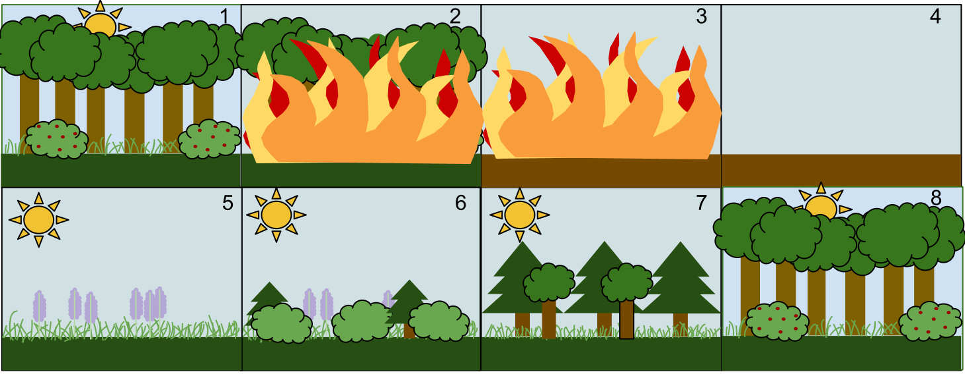
Secondary Succession

