Slide 1
Biogeochemical Cycles

Slide 2
Definition
Biogeochemical cycles are the flow of chemicals throughout the biological (living) and geological (non-living) parts of an ecosystem.
Chemicals could include elements or compounds.

Slide 3
Water Cycle
Mostly phase change of water
Occurs above and below ground
Exact path depends on biome
85% of evaporation occurs over oceans
99% of water is contained in oceans or bodies of salt water
75% of fresh water is locked in polar ice caps

Slide 4
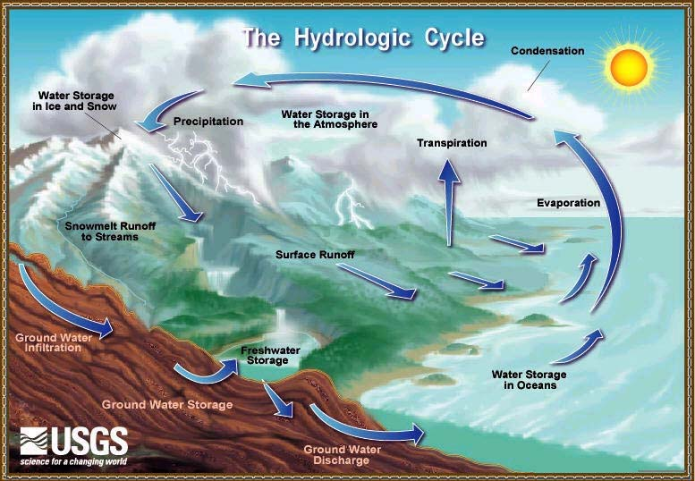
Water Cycle

Slide 5
Carbon Cycle
Majority of cycle occurs between respiration and photosynthesis
Some parts of the cycle are “non-renewable”
Large forests act as “carbon sinks” slowing the cycle due to the cellulose in wood

Slide 6
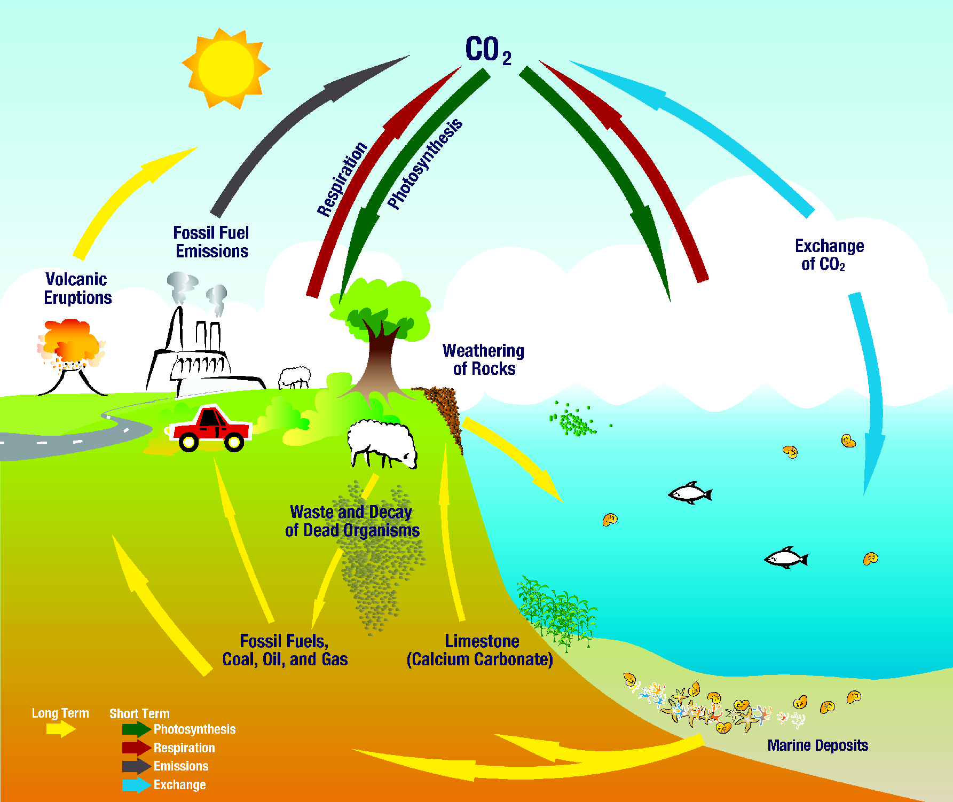
Carbon Cycle

Slide 7
Nitrogen Cycle
Mostly occurs below ground
Relies on various bacteria to make nitrogen useable by plants and animals as well as returning nitrogen to the air
Vital for the survival of plants
Lightening can also cause nitrogen fixation in the air which then enters the soil along with precipitation

Slide 8
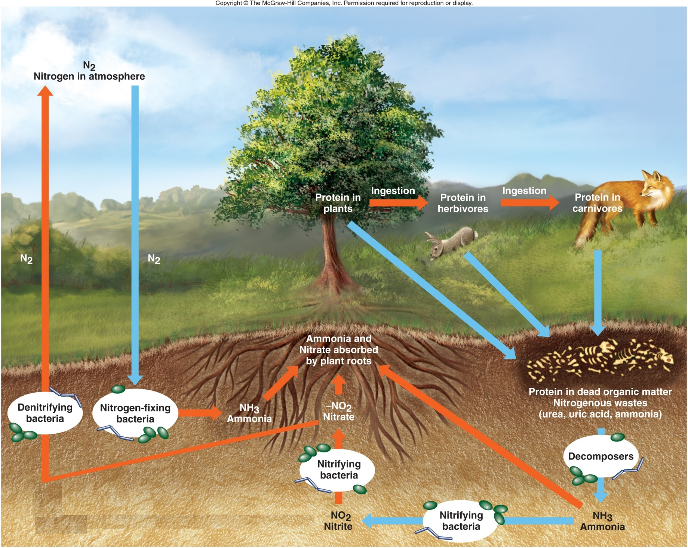
Nitrogen Cycle

Slide 9
Other Cycles
Oxygen Cycle: Entirely between photosynthesis and respiration
Phosphorous Cycle: Does not include an atmospheric portion, moves through the food web
Sulfur Cycle: know that it exists

